Slide 1
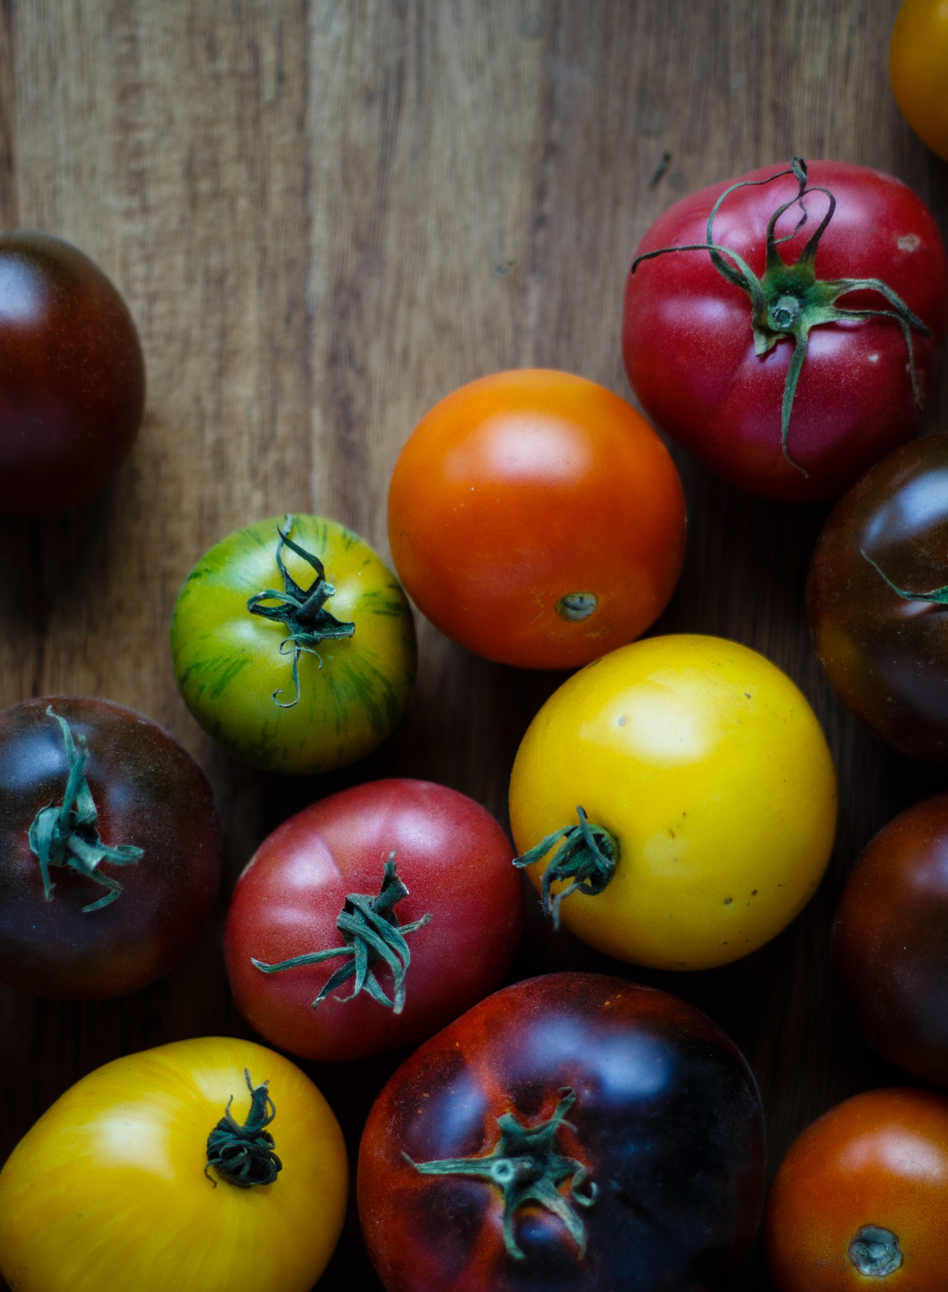
Culinary Consulting
Serena Garcia’s FoCo Project

Slide 2
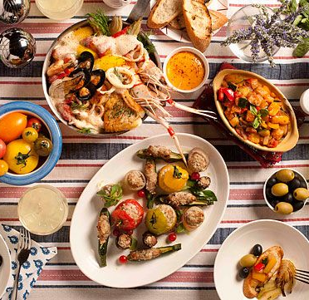
What Is Innato?
With an experimental kitchen located in the heart of Seattle, Innato is a woman-owned and led consulting business designed to help their clients reach their elevated culinary goals. Food is very important to them, and they want to portray to their clients that good food starts from fresh and high-quality ingredients and simple but well-done cooking processes.

Slide 3

Who are their clients?
Restaurant owners
Food product companies
Beverage companies
Boutique food stores

Slide 4

What are Innato’s design needs?
Clean, elegant logo that pays homage to nature’s beautiful food ingredients
Their color scheme must include warm and welcoming colors
Positive brand image to maintain a strong relationship with customers

Slide 5
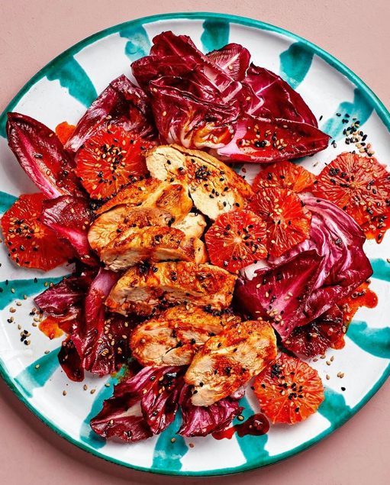
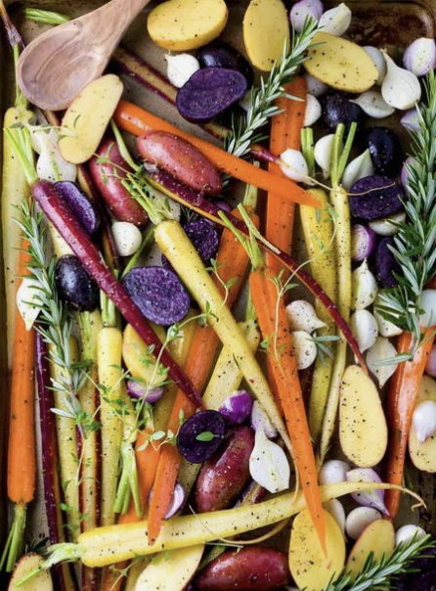
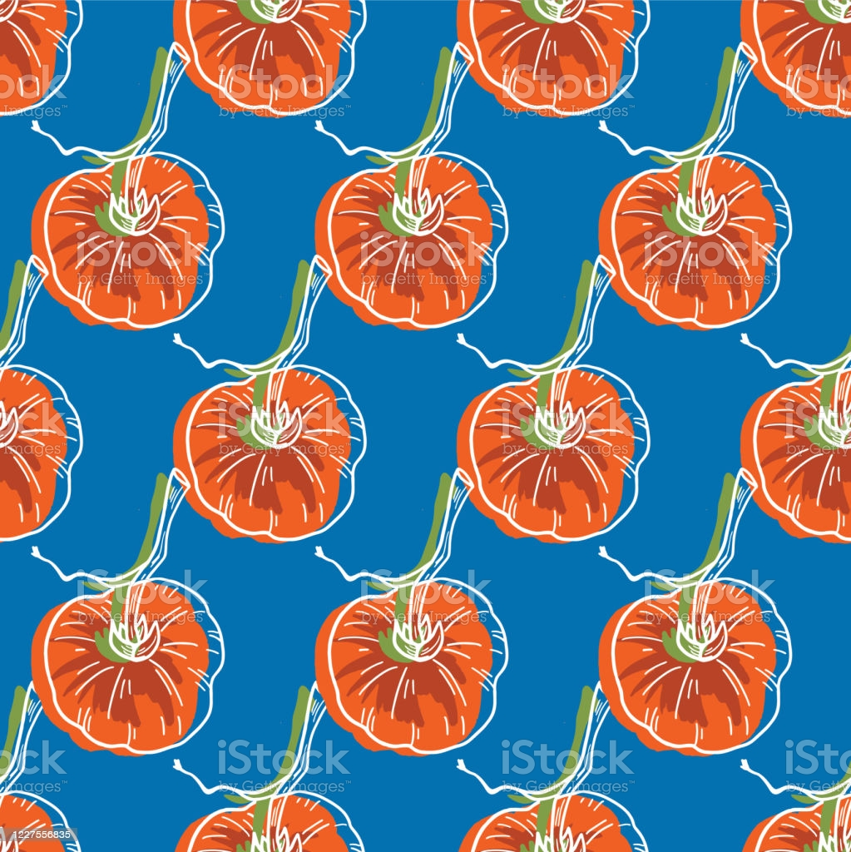
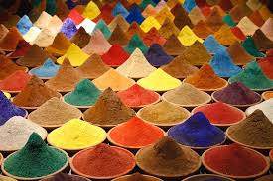

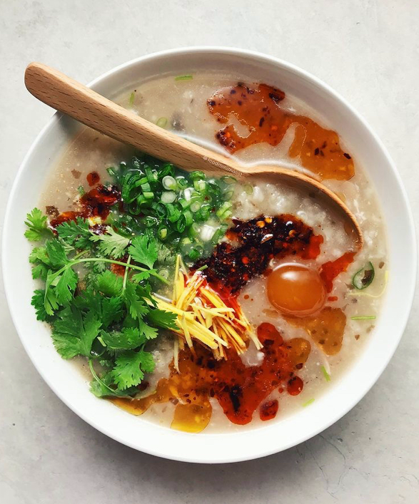

Mood Board

Slide 6
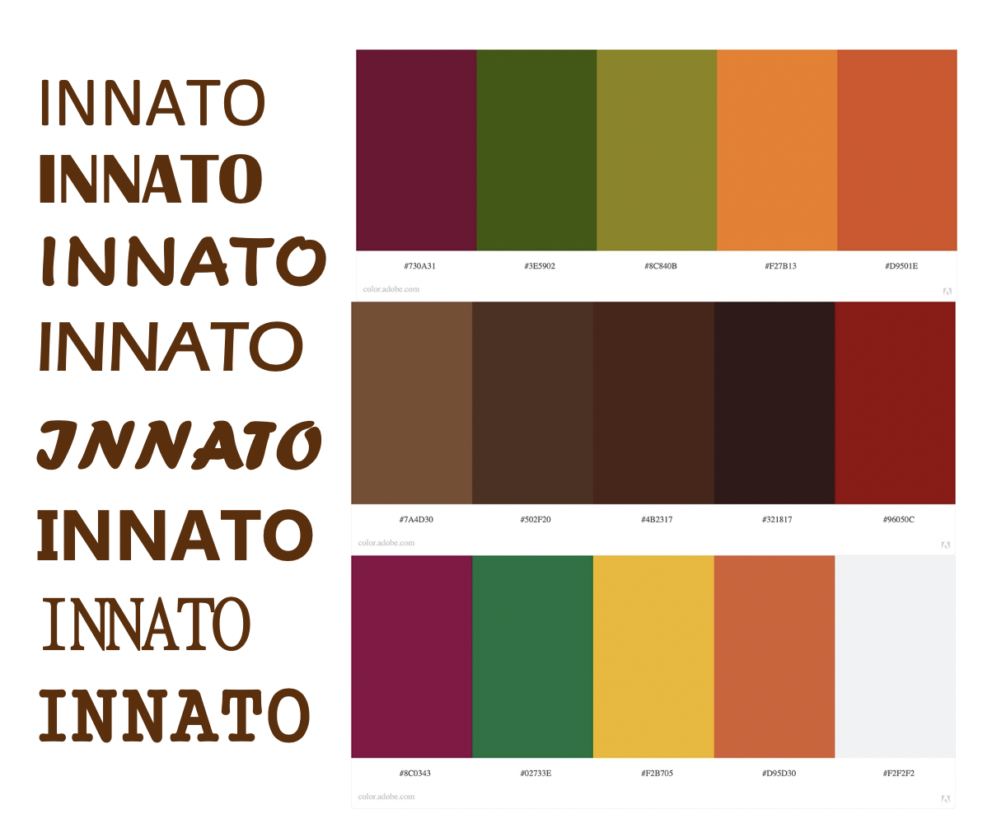
Color Scheme/ Font Ideas

Slide 7
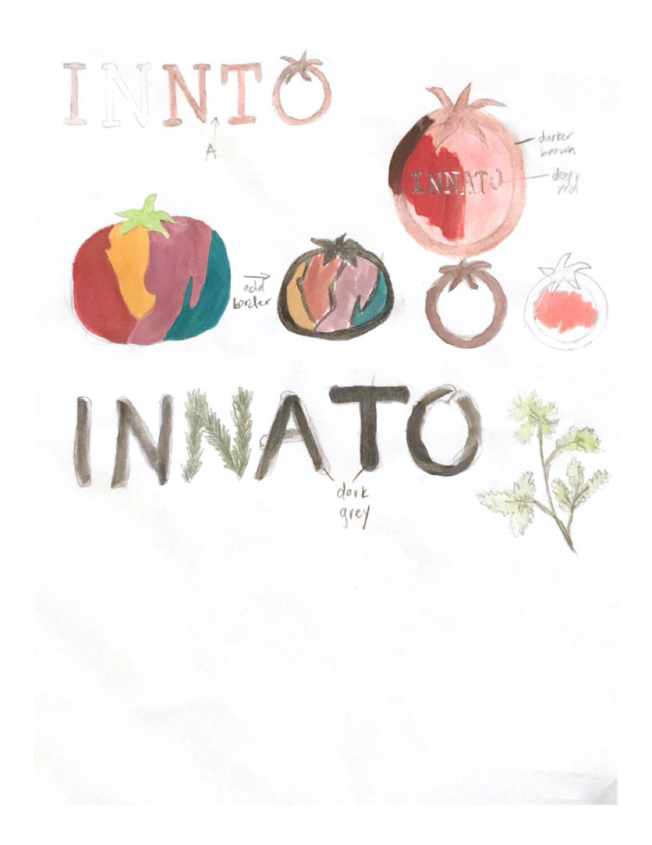
Logo Thumbnails

Slide 8
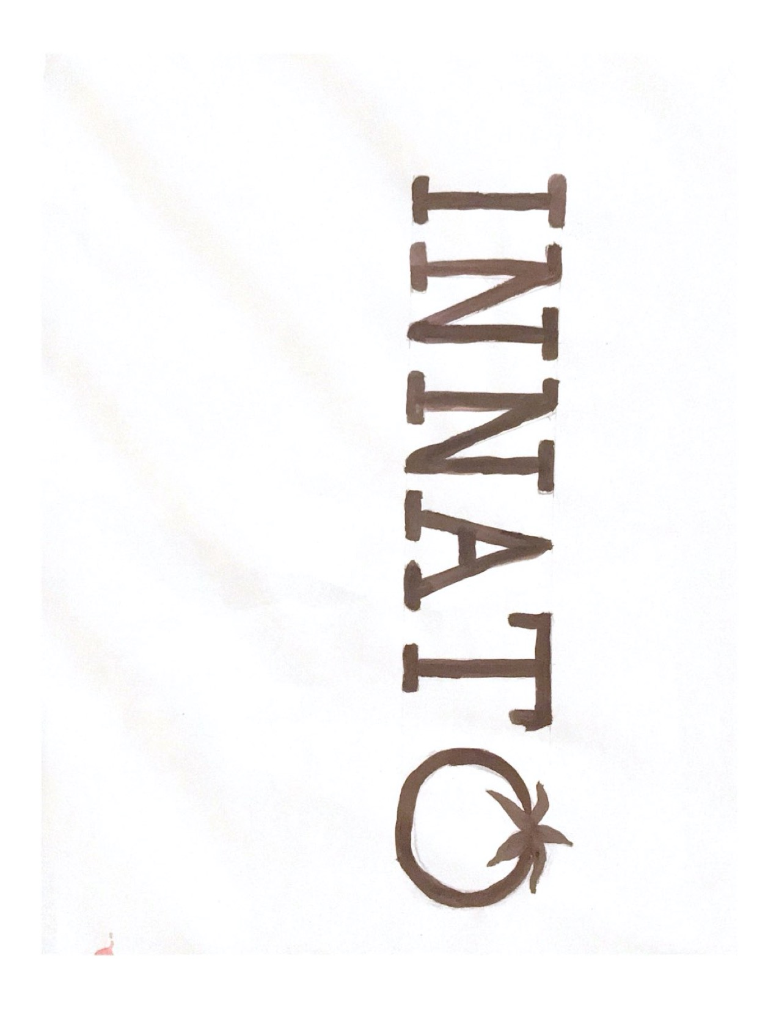
Rough

Slide 9
Final Logo

Slide 10

Business Card

Slide 11
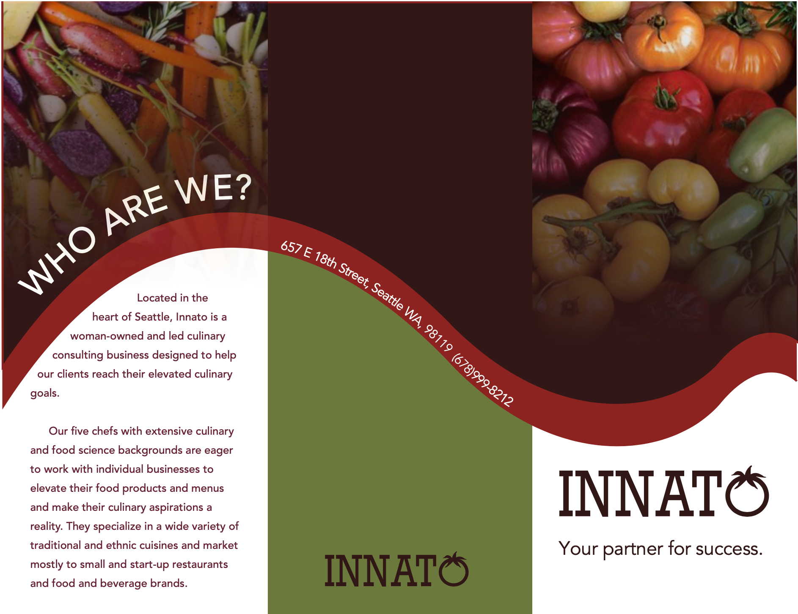
Brochure

Slide 12
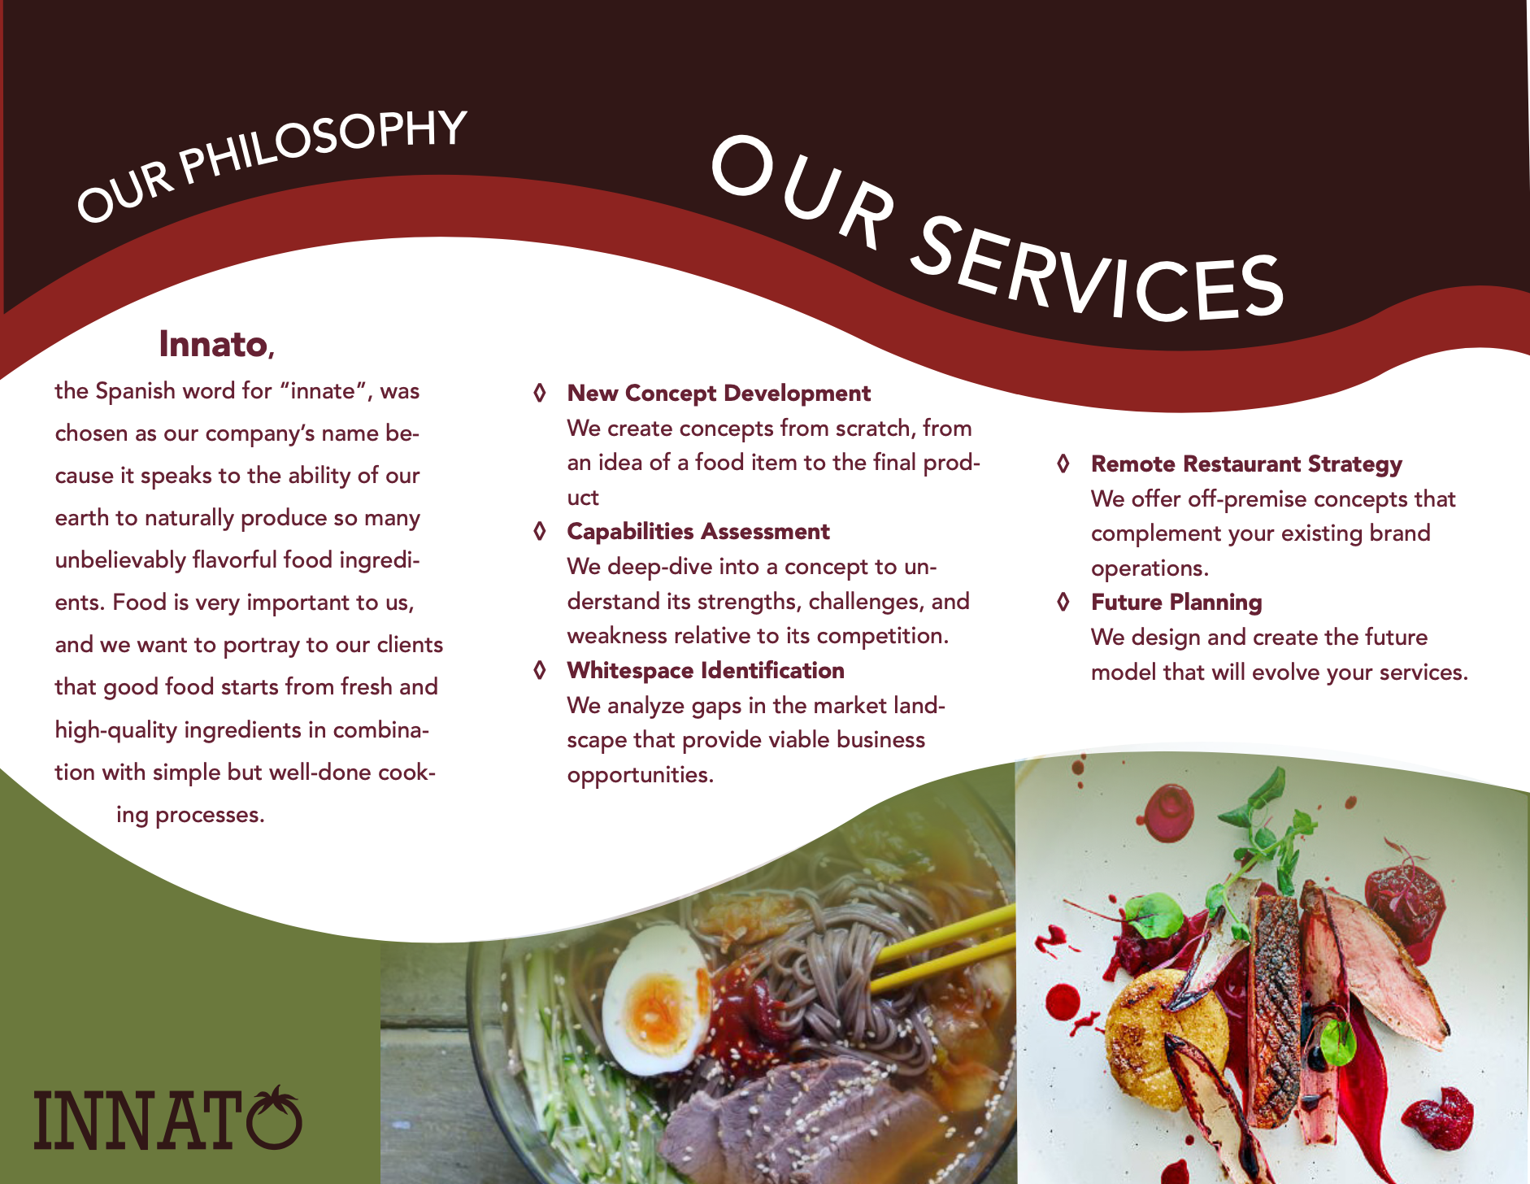
Brochure

Slide 13

Website

